Slide 1
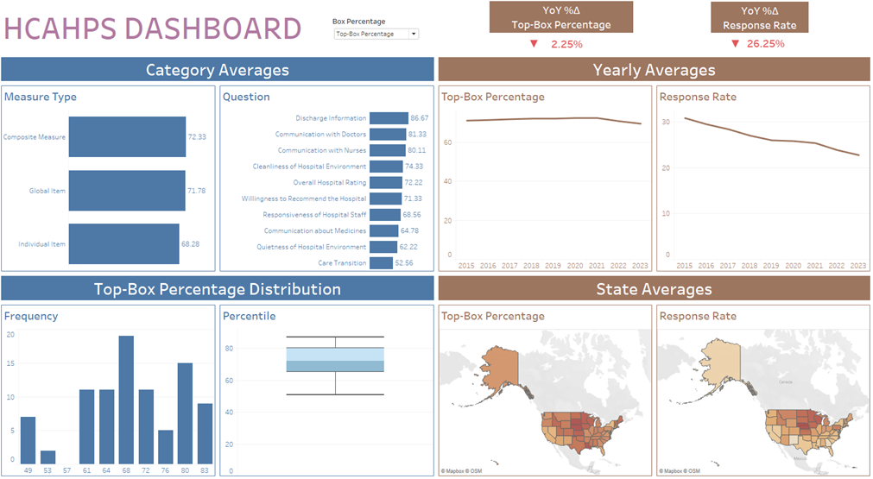

Slide 2
Abstract
I conducted an exploratory analysis of survey results for the Hospital Consumer Assessment of Healthcare Providers and Systems (HCAHPS).
I had to determine if patients’ hospital care has improved over the last nine years.
I created an interactive dashboard that summarizes the average box answer scores from the HCAHPS survey results.
I have uploaded all the files for this project onto my GitHub.

Slide 3
Data Cleaning Strategy
There survey dataset consisted of seven tables with mostly structured data.
Since the “Release Period” dates were all in July, I removed the month numbers and kept the years.
I converted all numbers in the tables into numeric data types.

Slide 4
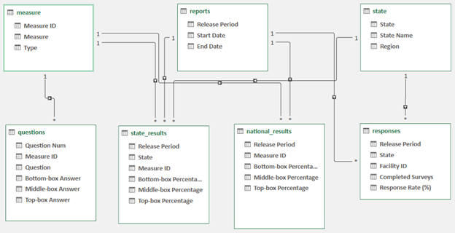
Data Model

Slide 5
Statistical Insights
Over the last nine years:
The average top-box percentage of answers dropped by 2.25%.
The average middle-box percentage of answers increased by 1.94%.
The average bottom-box percentage of answers increased by 14.29%.
The average response rate dropped by 26.25%.
Five-number summary of the box percentage of answers:
Top-Box: Min = 51%, Q1 = 65%, Median = 72%, Q3 = 80% Max = 87%
Middle-Box: Min = 0%, Q1 = 16%, Median = 19%, Q3 = 23%, Max = 43%
Bottom-Box: Min = 4%, Q1 = 5%, Median = 8%, Q3 = 10%, Max = 20%
Questions with the highest average box percentage of answers:
Top-Box: Discharge Information (86.67%)
Middle-Box: Care Transition (42.22%)
Bottom-Box: Communication about Medicines (17.78%)
Measures with the highest average box percentage of answers:
Top-Box: Composite Measure (72.33%)
Middle-Box: Individual Item (23.06%)
Bottom-Box: Composite Measure (8.96%)

Slide 6
Regional Insights
States in the Midwest had the highest average top-box percentage of answers.
States along the West Coast and Northeast had the highest average middle-box and bottom-box percentage of answers.
States in the Northern Midwest had the highest average response rate.

Slide 7
Recommendations
Conclusion:
Even though there was a decline in the average top-box answers over nine years, the average top-box answers were relatively high compared to the other box answers.
This means that, overall, patients are scoring positive responses to most of the survey questions in general.
Because of the decline in the average response rate over nine years, the confidence level of these survey results might need some improvement.
Suggestions for improvement:
Be more transparent about the cost of prescription drugs.
Optimize the training of healthcare professionals and the care that they give to their patients.
Make sure that healthcare providers are providing clear instructions to patients’ discharge information.

